Slide 1

GFT Delivery Model
January | 2025

Slide 2

Architecture and technology
AI.DA Marketplace
We use a mix of modern technology, methodologies and architectures to build scalable solutions that best solve the problem at hand.
Its main goal is to build extendable, scalable and future proof solutions that will change with the bank over time.
Find the right requirements – Event Storming, DDD, Discovery Framework
Right-sized microservices
API first
Event driven architecture utilizing modern message brokers like Kafka
Data Lake with advanced analytic capabilities - separate operational data from analytical data
Cloud native and scalable solutions
Reusable templates and standardization
Quality built in with test automation as the primary goal
Robust ecosystem of ready solutions
Modular and evolutionary approach
Slide owner: SAVX

Slide 3
Split work according to domains
General Ledger
Teams
PPI
Lending
Marketing Automation
DWH
Bounded Contexts
Loan Origination
General Ledger
Unsecured Lending
System Integrations
Process Management
Document management
Collections
Collections system
Loan Origination
General Ledger & Reporting
DMS
Channel
Core Banking
Reporting
International Payments
Payments
Payments
Customer
Company database
Customer
Cash desk
Fraud / AML
Risk Engine
Product Catalogue
Risk
Overnight Payments
Transaction
Credit Bureau
Loyalty
Product
CMS
Instant Payments
IAM

Slide 4

Self-sufficient teams
The roles in a typical squad
BUSINESS SUBJECT MATTER EXPERTS
Always in-house and provides business knowledge and regulatory requirements
BANK
PRODUCT OWNER
In-house
SCRUM MASTER
GFT or in house, can be shared between teams
MIX TEAMS
(GFT / BANK / VENDORS
BUSINESS ANALYSTS
In-house or GFT
FRONTEND DEVELOPERS
React, iOS, Android, UX
BACKEND DEVELOPERS
Java/Kotlin, Data Eng, Smart Contract, etc.
TECHNICAL BUSINESS ANALYSTS
Requirements engineers
QUALITY ASSURANCE
Testing from unit through Integration
QUALITY ASSURANCE
Testing from unit through Integration
DEVOPS & Cloud Eng
CICD & AWS experts
DEVOPS & Cloud Eng
CICD & Cloud experts
Architecture & Technical SME
System architecture, Data architecture, SME

Slide 5

Architecture & Way of Working
Independent Team Environments
Environment High Availability
The cloud provides automatic failover and redundancy, which enhances the availability of applications and services.
For example: GCP Cloud Spanner - Dual-Regional Instance have >= 99.999% SLA Availability
Managed Services and Access to Marketplace
Overall, it can be estimated that the three major cloud platforms spend between $7 and $9 billion annually on IT security globally
Confidential

Slide 6
Functional architecture – Retail
GFT Scope
Bank
Non exhaustive
FRONTEND LAYER
Accounts Management
Refer a friend
Transfers
IPO & Investments
Document Issuance
My Profile
AuthN AuthZ
Admin Portal
Client / Employee Engagement
Card Services
Statements
SAB Store
SADAD Bills
Beneficiaries Management
My Messages
SAB Loyalty Program
Virtual Card Management
Government Services
PFM
Global View
SERVICES FULFILMENT LAYER
Business Workflows
Accounts Bounded Context
Cards Bounded Context
Loyalty Program BC
Govt Services BC
Customer Mgmt BC
Payments BC
Referral Mgmt BC
Backend to Frontend
services
Common Business Services
Statement Service • Notifications • Document Management. • Content Management • Security • Activities • Messages • Audit
DATA & MESSAGING LAYER
Storage and Integration
services
ESB
Kafka
MQ
Mule
Near-real time
Data Access Layer
RECORD LAYER
CORE
BLIK
DMS
CRM
Core Systems, System of Records, Shared Functions
KIR
Risk Management
Governance & Compliance
Treasury Operations
Forex

Slide 7
Architecture Flow: Preparation, Build&Launch, Post Launch
 | Discovery | Project Setup | Design | Verify & Approve | Implement | Continuous Improvement
Tasks | Understand AS-IS architecture Define TO-BE architecture Define intermediate steps Perform gap analysis Define high-level non-functional requirement Define bounded contexts | Choose key technologies Choose 3rd party systems Approach to existing systems and functionalities (retain, replace, retire) Define team shapes Assign context to teams Define Teams high level backlog | Define feature level architecture within a bounded context Define integration points between 3rd party systems and other bounded contexts Create C2 level architecture and if needed C3 or other diagrams Analyse and design integration points | Verify if the designed architecture fulfils the functional requirements and meets the NFRs Discuss architecture with architecture chapter Present and get approval from design body | Transfer knowledge to tech lead and oversee task creation Answer any questions arising from the team during implementation Participate in Demo session showcasing the functionality Add any new architecture patterns to the architecture repository | Measure and monitor the system Based on feedback, bugs and new feature requests improve the architecture
Outcomes | C1 level architecture Key NFRs definition Key architecture drivers definition Documentation standards Context map Scope of the next build phase | Tech stack Definition of key integrations Target architecture Team composition Initial backlogs | C2 level architecture Other architecture diagrams if needed to illustrate the concepts API definitions Data model | Design document approved by the architecture decision body | Functionality delivered to development environment Architecture pattern repository updates | Architecture aligned to meet new functionalities Architecture aligned to better meet functional and non-functional requirements
Involved People | Program level architects Key business and technology stakeholder Governance team Subject Matter Experts | Program Level architects Key business and technology stakeholders Governance team | Stream assigned architects Subject Matter Experts 3rd party system experts (if needed) Tech lead Business Analyst | Stream assigned architects Program level architects Architecture decision body | Stream assigned architects Tech lead Development team | Stream assigned architects Tech lead Development team Business stakeholders Operations team
Notes:
Add double click - expand out - clients /
Ask ourselves if client examples are referencible
Bring to life culture in Strategy
Add in enablement / GFT & TM involvement - product innovation council (life after suffiency)
Change to Pre-Launch, Launch, Post Launch
Architecture - ARB?
GFT - involvement - bell curve in background -
Use colour scheme (slide 3) - Prelaunch - TM, McKinsey, OW, BCG
Barclays slide
Post launch -
Send to Anja -
Language specific model - TM Prime -
First Capital - First House - Dubai / Ben?
Always provide a range

Slide 8
Business and non-functional analysis Building roadmap and target delivery plan
Business backlog
Product Features Analysis
User Journey Analysis
Technical backlog
Core banking responsibilities
Core Banking Gap Analysis
Initial decision log
Flow analysis
Outcome
Roadmap
Bounded contexts
Streams of work
C1 / C2
Dependencies
Epics
User Stories
Team structure
Platform engineering
Cloud Transformation / LZ
Self-hosted applications / integrations
Cost estimates
Ways of Working / Governance

Slide 9
Architecture, designs & frameworks
Customer Experience Framework
Omni-Channel Design
Micro-Frontend Architecture
Microservices Architecture
Domain-Driven Designs
Event-Driven Architecture
Cloud-Native Architecture
Contract-First Approach
Automated Testing Framework
Agile & DevOps Implementations
Enabling non-functional requirements:
User Experience
Scalable
Secure
Highly Available
Fault Tolerant
Data Integrity
Real-Time Data Availability
Highly Concurrent

Slide 10


GFT can support you end-to-end: Design, Build, Launch & Maintain
Discovery & Design
Tech
Delivery
Launch
Run
Product definitions
Integrations
Legacy strategy
Migration roadmap
High-level blueprint
Design, UI/UX, and Branding
Prototyping
Processes
Requirements
Compliance
Ecosystem
Architecture
Tech Stack
Cloud Infrastructure
Data Lakes
3rd Party Systems
Artifacts and assets
Identify, Define, Track & Manage Implementation
Launch, Scale, Industrialise & Optimise
Run, Support the Platform
Managed Services
…and provide you with end-to-end capabilities, skills, and programme governance

Slide 11







Client Flow: Pre-Launch, Launch, Post Launch
 | Strategy | Product Strategy | Architecture | Build | Migration | Operations & Maintenance | Client Self Sufficiency
Definition / Components | Business market positioning Digital transformation objectives Future-proof target scenario | CBS selection Target Banking products E2E impact in current ecosystem Modernisation objectives | Functional Components Technical Platform and Technical Validation Partner Ecosystem Definition | Architecture & Orchestration Functional Dev E2E Integration Rollout to production Stakeholders' coordination | Migration Functional Scope Migration Strategy Migration Execution | Production support Maintenance Continuous improvements | Combined SI & Client roles in key positions Team structure evolution throughout project life-cycle Collaboration on client’s enablement
Outcomes | Business objectives Business Cases Functional blueprint Technical blueprint Infrastructure blueprint Organisation blueprint | Product lifecycle Technical PoCs HL Customer Journey HL Architecture HL SW Engineering HL Operating model | HL Functional Arch HL Technical Arch Infra requirements 3rd Party evaluation Project plan | Funct & Tech document E2E Build Systems / Partners Integrat Smart Contracts Development Infra setup Testing & Deployment Operating model | E2E Processes redefinition Target Systems analysis Gap Analysis Data Migration | Problem Mgmt Incident Mgmt Change Mgmt Communication with 3rd Party vendors | Routine, Structures & Organisational plan Knowledge Transfer Validation Shadowing / Reverse Shadowing Hypercare Plan Strong Exchange
GFT USP | Ability to work with strategy partners through an array of real-world examples | Deep Functional banking product lifecycle knowledge & experience and E2E business process design | Experience in aligning technology capabilities with business objectives and requirements, including 3rd party integrations | Delivery excellence according to culture, people and business needs & experience in change management upskilling (e.g., legacy to modernisation knowledge) | Real experience in large banking data migration projects including business knowledge and technical expertise | Providing support and training for future success by leveraging deep Thought Machine knowledge | Proactive integration with GFT teams Best iteration & cross-training Best & updated runbooks & reference documents
Client Example
Tier I US Bank
Tier I US Bank
£
Tier I EU Bank
Tier I US Bank
Tier I EU Bank
Tier I EU Bank
Tier I US Bank
* General cost curve (includes retirement of legacy assets)

Slide 12
GFT delivery management, service quality, and assurance
Consistent framework for delivery
Facilitating cultural shifts needed to drive continuous Leadership in Agile and continuous improvement
Understanding business value, embedding it into all aspects of delivery
Partnership success at our core, fostering and growing the relationship
Driving client self-sufficiency, service adoption & post deployment support
Comprehensive framework that covers initiation and delivery of a range of contracting models
Identifying efficiencies and automation opportunities with domain driven development & fully automated testing
Proactive risk mitigation and issue resolution
Access to business & technology thought leadership
Notes:
GFT embraces global delivery management processes aligned to industry quality standards, embracing “Do it once, do it right”, minimising operational risk, whilst delivering high quality to clients.
GFTs delivery method is aligned to industry best practices & quality standards, with a delivery-hardened approach to running agile technology projects that is thoroughly tested and actioned within the wider industry and in particular the numerous projects delivered within digital banking space. Project management elements are derived from industry best practices including SAFe and MSP. GFT’s approach minimises operational risk, whilst delivering actual business benefit and savings to the bank at high cadence:

Slide 13
Joint Delivery Model
Typical delivery model in collaboration with client teams
*GFT can also provide those functions which are usually delivered by in-house teams, such as business analysts, UX professionals, and product ownership
Program Leadership And Steering
Pmo Function
Bank Teams
*Product Ownership, Business Analysis And Regulatory Engagement
Supported By Subject Matter Experts
*UI/UX, User Journeys And Client Engagement And Experience
Engineering And Delivery
Mix teams
(Bank + GFT + Other Vendors)
Infrastructure Management And Devops

Slide 14
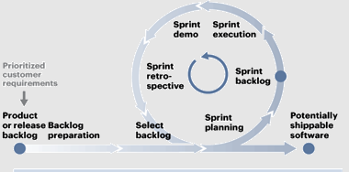
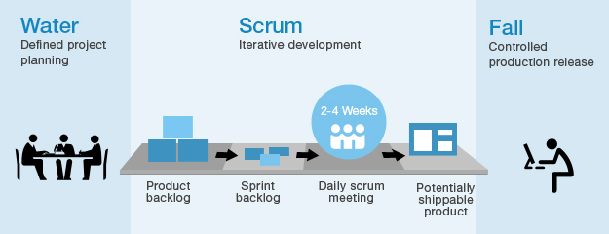
Agile Approach
GFT promotes agile values and culture to foster a focused, commited and collaborative environment in joint teams to enable the delivery of customer value through fast, continous and high-quality software.
Agile based delivery model
Based on SCRUM fraework
Incremental and iterative development
Customer-oriented backlog
Empowered teams, end-to-end responsibility
Frequent delivery and feedback
Early validation through stakeholder participation
Focus on learning
Flexible enough to adapt to the different phases of the project, where a waterfall or mixed methodology can do better
Working iteratively in the development of new functionalities through multidisciplinary teams integrated with the business
Iterative model startup process
Create Project
Vision
Identify Scrum Master and Stakeholders
Form Scrum
Team
Develop Epics
Create Prioritized Product Backlog
Conduct Release Planning

Slide 15
GFT Approach for organisation / team structure
Our organization leverages Agile Release Trains (ARTs) and Team Topology to align teams with business domains and value streams. This approach, guided by Conway's Law, ensures our system architecture naturally reflects and supports our organizational structure
Team Topology
ARTs
CoE Model
Combining Team Topologies with Agile Release Trains (ARTs) involves designing team structures and interactions that align with value streams while optimizing for autonomy, focus, and flow.
Use CoE for domains requiring governance, best practices, and cross-team alignment
Notes:
Using **Team Topologies**, **Agile Release Trains (ARTs)**, and **Centers of Excellence (CoEs)** together provides a robust organizational framework that combines the strengths of each model. This synergy enables organizations to optimize team structures, scale effectively, and build specialized expertise. Here's an overview of the benefits of integrating these three models:
---
### **1. Better Alignment with Value Streams**
- **Team Topologies:** Stream-aligned teams focus on delivering value directly tied to customer and business outcomes.
- **ARTs:** Align multiple agile teams with value streams for coordinated delivery at scale.
- **CoEs:** Provide expert guidance and tools to ensure stream-aligned teams follow best practices and meet organizational standards.
**Benefit:** The combination ensures that teams and ARTs deliver high-quality outcomes while staying aligned with business priorities and leveraging expert input when needed.
---
### **2. Enhanced Collaboration and Interaction**
- **Team Topologies:** Defines clear interaction modes (collaboration, facilitation, service) for teams, reducing friction.
- **ARTs:** Facilitates collaboration across teams within a program increment (PI) through regular events like PI Planning and Inspect and Adapt workshops.
- **CoEs:** Act as knowledge hubs, facilitating collaboration by providing reusable assets, frameworks, and expertise across ARTs and teams.
**Benefit:** Clear interaction patterns between teams, ARTs, and CoEs minimize silos and improve coordination across the organization.
---
### **3. Scalability and Adaptability**
- **Team Topologies:** Provides a framework for evolving team structures as organizational needs change.
- **ARTs:** Scale agile delivery across the enterprise by grouping multiple teams to work in alignment.
- **CoEs:** Help scale expertise and best practices, ensuring that specialized knowledge is shared and applied consistently.
**Benefit:** The organization can scale effectively while ensuring teams remain agile, adaptive, and focused on value delivery.
---
### **4. Accelerated Delivery with Specialized Expertise**
- **Team Topologies:** Enables specialized teams (e.g., enabling, platform, complicated subsystem) to accelerate delivery by unblocking stream-aligned teams.
- **ARTs:** Ensure synchronization of delivery efforts across teams for predictable, incremental value delivery.
- **CoEs:** Provide domain expertise (e.g., DevOps, AI/ML, compliance) to solve complex challenges and improve efficiency.
**Benefit:** Specialized expertise is seamlessly integrated into agile delivery, reducing bottlenecks and enhancing delivery velocity.
---
### **5. Improved Quality and Consistency**
- **Team Topologies:** Focus on team autonomy while ensuring alignment through platform and enabling teams.
- **ARTs:** Align team efforts to ensure that all deliverables meet shared PI objectives and quality standards.
- **CoEs:** Define best practices, standards, and frameworks that ensure quality and consistency across teams and ARTs.
**Benefit:** Quality and consistency are baked into delivery processes, even in large-scale, complex environments.
---
### **6. Continuous Improvement and Innovation**
- **Team Topologies:** Encourages teams to evolve their structure and processes to improve flow and reduce cognitive load.
- **ARTs:** Foster a culture of continuous learning through Inspect and Adapt workshops and retrospectives.
- **CoEs:** Drive innovation by exploring new technologies and practices, then disseminating insights to teams and ARTs.
**Benefit:** The combined approach promotes a culture of continuous learning and innovation at both the team and organizational levels.
---
### **7. Stronger Governance and Risk Management**
- **Team Topologies:** Provides clarity on team roles and responsibilities, reducing ambiguity in governance.
- **ARTs:** Synchronize delivery efforts, ensuring governance is maintained across large-scale initiatives.
- **CoEs:** Focus on areas like compliance, security, and data governance, ensuring that all teams adhere to organizational and regulatory requirements.
**Benefit:** Risk is proactively managed without sacrificing agility or speed.
---
### **8. Increased Employee Engagement**
- **Team Topologies:** Reduces cognitive load by structuring teams to focus on specific domains.
- **ARTs:** Foster a sense of purpose and collaboration through alignment with value streams and regular planning events.
- **CoEs:** Provide opportunities for skill development and career growth by allowing employees to specialize and innovate.
**Benefit:** Employees feel empowered, supported, and motivated, leading to higher engagement and retention.
---
### **9. Faster Time-to-Market**
- **Team Topologies:** Streamlined teams focus on delivering value without unnecessary handoffs.
- **ARTs:** Coordinate cross-team efforts for predictable, incremental delivery.
- **CoEs:** Accelerate delivery by providing reusable frameworks, tools, and best practices.
**Benefit:** Reduced delivery bottlenecks and optimized workflows result in faster time-to-market.
---
### **10. Improved Organizational Resilience**
- **Team Topologies:** Encourages adaptable team structures that evolve as the organization grows.
- **ARTs:** Provide stability and predictability in delivery while allowing for adjustments during PI cycles.
- **CoEs:** Centralize expertise and innovation, enabling the organization to respond quickly to changes in technology or market demands.
**Benefit:** The organization becomes more resilient and better equipped to handle challenges and seize opportunities.
---
### **Conclusion**
By integrating **Team Topologies**, **ARTs**, and **CoEs**, organizations can achieve a powerful balance of **autonomy**, **alignment**, and **expertise**. This combination enhances collaboration, scalability, quality, and speed while fostering continuous improvement and innovation. It creates a resilient organization capable of delivering value efficiently and adapting to change.

Slide 16
GFT Approach for organisation / team structure
Our organization leverages Agile Release Trains (ARTs) and Team Topology to align teams with business domains and value streams.
This approach, guided by Conway's Law, ensures our system architecture naturally reflects and supports our organizational structure
Governance
Stream aligned
UBF
Loan Origination
VLEL Unsecured Lending
Customer
Payments
Ops dashboard
GL&RR
Architecture
Enabling
Testing
Mobile SDK
Mobile SDK
Complex subsystem
CBS
Canter of Excellence
CBS
Workflow
Shared Services
Data platform
Platform / shared services
Web platform
Cloud / Infrastructure
Release / Go live

Slide 17
GFT Approach for organisation / team structure
Our organization leverages Agile Release Trains (ARTs) and Team Topology to align teams with business domains and value streams.
This approach, guided by Conway's Law, ensures our system architecture naturally reflects and supports our organizational structure
Cash Loan ART
Governance
Stream aligned
UBF
Loan Origination
VLEL Unsecured Lending
Customer
Payments
Ops dashboard
GL&RR
Architecture
Enabling
Testing
Mobile SDK
Mobile SDK
Complex subsystem
CBS
Canter of Excellence
CBS
Workflow
Shared Services
Data platform
Platform / shared services
Web platform
Cloud / Infrastructure
Release / Go live

Slide 18
Proposed Governance Structure
Steering Committee
CLIENT + GFT
Programme Management Forum
CLIENT + GFT
Business Design Authority
Solution Design Board
Technical Design Authority
Information Flow
Status
Risks/Issues Dependencies
Technical
Designs
Stream Align Squads
Enabling Squads
Complex Subsystem Squads
Platform Squads
Team Topology Squads
Notes:
GFT recognises the critical importance of a robust and high performing programme governance capability. Getting this element right will be fundamental to the success of the initiative. We must jointly ensure that communication, controls and continual dialogue occurs between all relevant parties and Bank own internal governance forums.
Our standard governance is shown below. This structure can be discussed, evaluated and finalised with the bank leadership during mobilisation and discovery

Slide 19
Building self-sufficiency to ensure the bank completely take overs the program after go live Closely integrated teams, access to learning and development of a CoE model
Joint Delivery Model
Dedicated Centre of Excellence
Partner and Knowledge Transfer approach
Supporting tools
“You built it you run it” and GFT AMS
Combined and integrated development and engineering squads
Use Polish delivery centre to build a dedicated CoE for the Bank
Tailored model to support the Bank to build required capability in house
Transition matrix and knowledge base
Run the program in you build it you run it model and transition to GFT AMS service

Slide 20

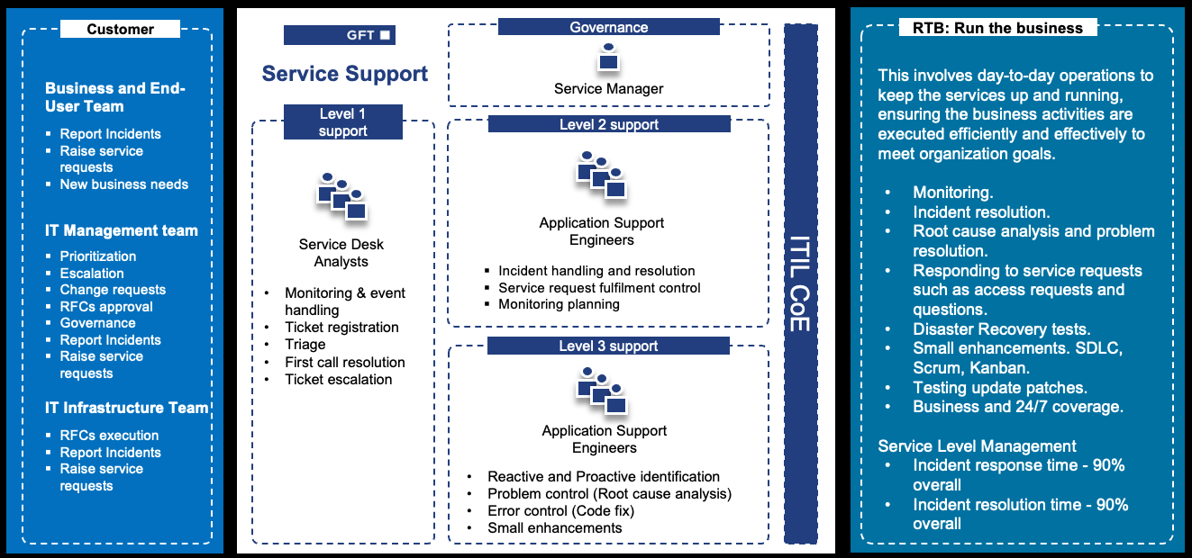
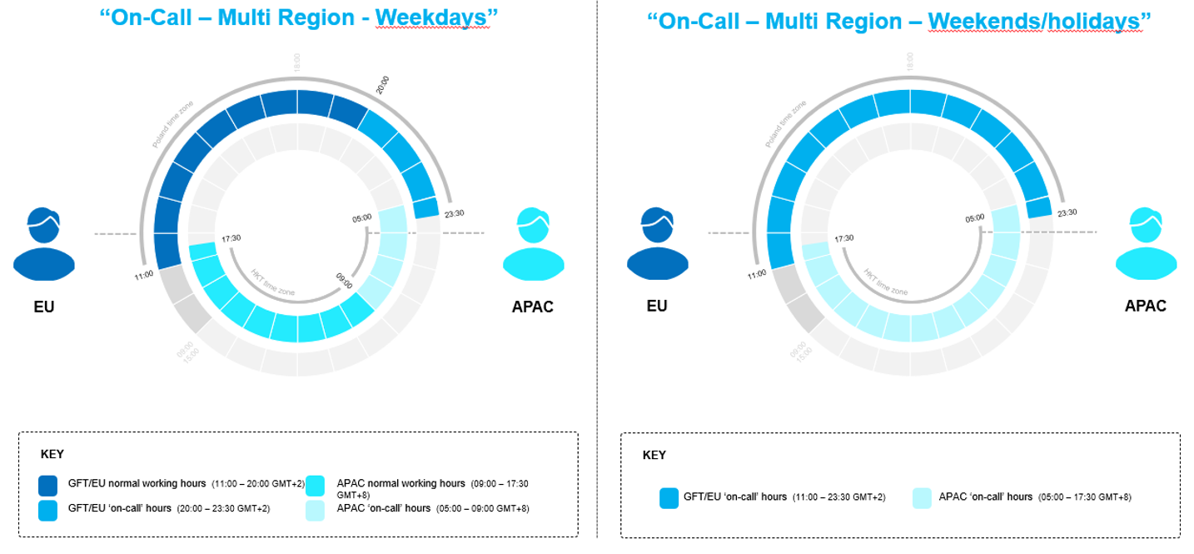
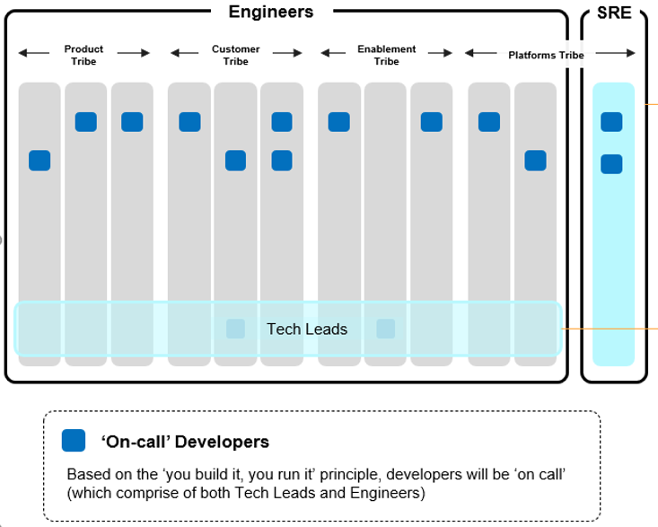
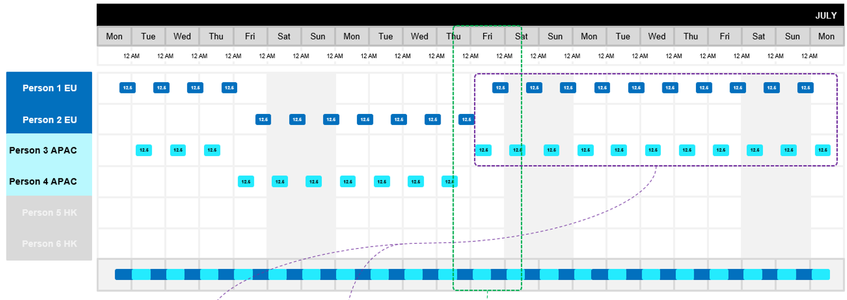
“You built it you run it” and GFT AMS
You built it you run it
GFT AMS
“You build it you run it” principle
Support required 24 hours a day, 7 days a week, 365 days a year (weekends and public holidays included)
On-call reaction required for P1 and P2 incidents (you will be called out via Pager Duty)
Half-day (12.5 hours) of coverage required when on rota
Support rota schedule agreed monthly on squad level
Responding and handling incidents is main duty when person is on rota for that day. Meetings, planned backlog work and other activities are secondary comparing to incidents
Ensures IT services are delivered as required, utilizing the IT organization’s technical and human resources as best as possible.​
Ongoing support, management, and maintenance of software applications.
Relief of your internal IT specialists.
Focus on strategic projects.
Efficient resource utilization at high quality.
Quick response to changes in the landscape.
Reduction of service-related risks.

Slide 21

Slide owner: KAHM
V01
Remove slide if V02 is used
gft.com
info@gft.com
blog.gft.com
twitter.com/gft_tech
linkedin.com/company/gft-technologies
facebook.com/GFTGroup
Notes:
GFT Brasil Consultoria Informática Ltda.
GFT Costa Rica S.A.
GFT Financial Limited
GFT France S.A.S.
GFT IT Consulting S.L.U.
GFT Integrated Systems GmbH
GFT Invest GmbH
GFT Italia S.r.l.
GFT México S.A. de C.V.
GFT Poland Sp.z.o.o.
GFT Real Estate GmbH
GFT Schweiz AG
GFT Technologies Belgique S.A.
GFT Technologies Canada Inc.
GFT Technologies Hong Kong Ltd.
GFT Technologies SE
GFT Technologies Singapore Pte. Ltd.
GFT Technologies Toronto Inc.
GFT Technologies Vietnam Limited
GFT Treasury Services GmbH
GFT USA Inc.

